Slide 1


Balancing power in peer support
Peer2Peer slides : module three,
session four
Module 1: Introducing Peer Support

Slide 2

Learning intentions
Understand the power peer workers have and the influencing factors
Explore how the peer values can be practiced to balance power in peer relationships
Explore the roles that may arise in peer relationships and the impact of power, choice and control
Peer2Peer: Module three – Peer concepts and practice

Slide 3





Group learning agreement
Connections
Device free environment, maintaining confidentiality
Hope
Focusing on the possible
Identity
Respect everyone's individuality
Meaning
Value different perspectives, even if we don’t all agree
Empowerment
Give everyone a chance to speak
Peer2Peer: Module three – Peer concepts and practice

Slide 4

What’s a small way you have used your power recently that had a positive impact on someone else?
Checking in question
Peer2Peer: Module three – Peer concepts and practice

Slide 5
Understanding power dynamics
Power dynamics can affect how people communicate, relate, and trust each other. They can have positive or negative impacts on the outcomes of peer support.
Even mutual relationships, peer workers inherently hold more power. Acknowledging this helps shape the dynamic and build trust.
Power can appear through:
Structural power (systems and roles)
Relational power (how we interact)
Internal power (our experience)
Peer2Peer: Module three – Peer concepts and practice

Slide 6
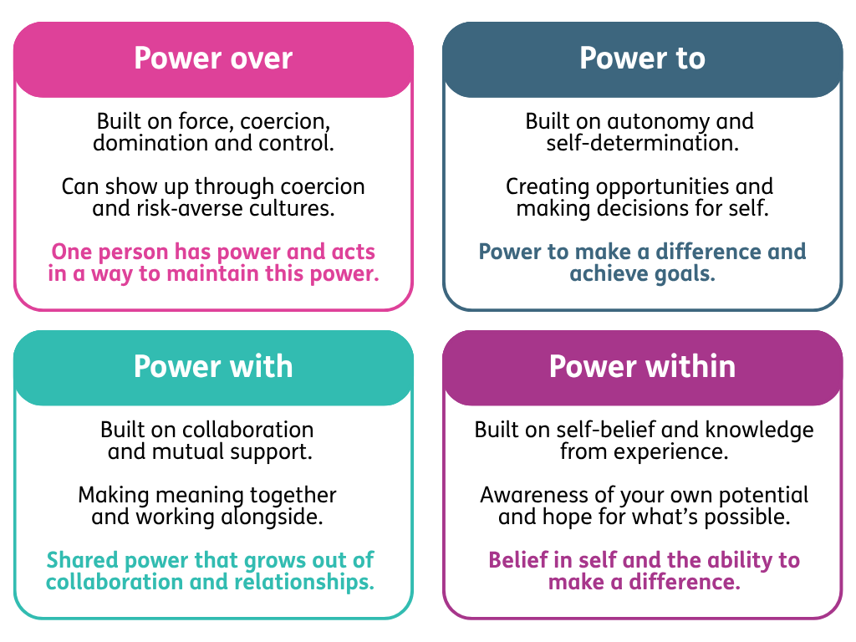
Understanding power dynamics
Peer2Peer: Module three – Peer concepts and practice

Slide 7
Activity one: Recognising power
Individual reflection
Complete the self-reflection activity in the workbook on what power you hold and what is outside of your power
Group discussion
What kinds of power might a peer worker have, even in a relationship that aims to be equal?
What influences how much power a peer worker holds?
Peer2Peer: Module three – Peer concepts and practice

Slide 8

Break
Peer2Peer: Module three – Peer concepts and practice

Slide 9
Empowerment
Empowerment is the process whereby people take control of their lives. It can be understood as having a sense of personal strength and by having control over one’s life.
Power is rarely something that can be “given” to someone. Instead peer support creates conditions where people can take more power and control for themselves.
Empowerment can also emerge in negative circumstances, such as when anger or injustice is a motivator for social change. This reflects the social‑justice roots of peer support.
Peer2Peer: Module three – Peer concepts and practice

Slide 10
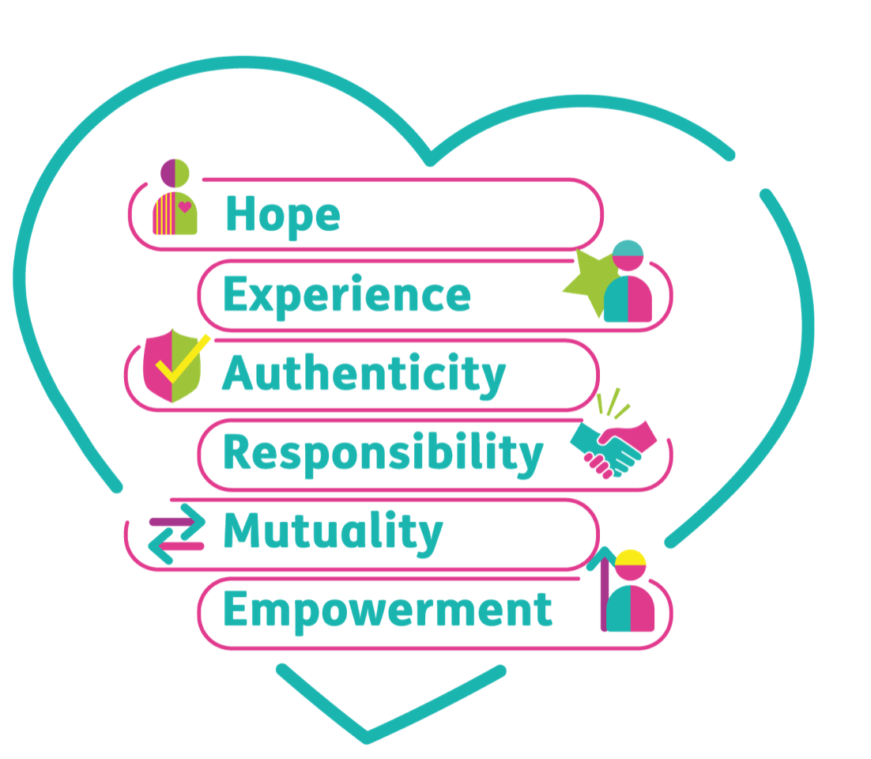
Disempowerment
The opposite of empowerment is disempowerment. Understanding how power may be taken away can develop our learning on how to take it back.
Peer workers can also unintentionally disempower others by assuming their needs or stepping into “fixing” and “rescuing” roles.
Practicing peer values (such as
empowerment and mutuality)
helps keep power balanced.
Peer2Peer: Module three – Peer concepts and practice

Slide 11
Activity two: Mutuality and empowerment
role play
In pairs, you will role play either a scenario from the workbook, or one you have created.
Round one: Negative response
The person playing the peer worker should respond to the scenario in a way that disempowers and is non-mutual. After the role play, reflect on:
In what ways did the peer worker disempower and not practice mutuality?
How might this response impact the relationship?
Peer2Peer: Module three – Peer concepts and practice

Slide 12
Activity two: Mutuality and empowerment
role play
Round two: Positive response
Use the same scenario but this time, respond in a positive way which would practice empowerment and mutuality. After the role play, reflect on:
In what ways did the peer worker practice empowerment and mutuality?
How might this response impact the relationship?
Peer2Peer: Module three – Peer concepts and practice

Slide 13
Power, choice and control
Peer workers can sometimes fall into familiar helping roles, especially roles that involve taking charge, fixing things or stepping in as the "rescuer".
Exploring our own experiences of support can reveal patterns that shape how we show up in relationships. These patterns often relate to power dynamics such as making assumptions and taking over decision making.
Employed peer workers should be particularly aware of these power dynamics as being paid for the role can amplify the sense of authority or expertise in the relationship.
Peer2Peer: Module three – Peer concepts and practice

Slide 14
Activity three: Power and roles in the peer relationship
You have been in a peer support relationship with Sue for a couple of months and things seem to be progressing well. She has told you how much she enjoys working with you and you’re feeling pretty confident.
Today she tells you that she is afraid of talking to her doctor about decreasing her medication. Sue knows that you successfully reduced your medication in the past and asks you to talk to her doctor on her behalf.
Peer2Peer: Module three – Peer concepts and practice

Slide 15
Activity three: Power and roles in the peer relationship
In groups, you will be assigned an approach to respond to Sue. Role play together how this approach may play out in real life.
Group discussion 1
Capture your reflections in the participant workbook
Who holds the power in this approach?
(refer back to the power framework if helpful)
What impact may this approach have on the peer worker’s relationship with Sue?
Peer2Peer: Module three – Peer concepts and practice

Slide 16
What assumptions you hold about Sue
Activity three: Power and roles in the peer relationship
Group discussion 2
Now think of a way to respond to Sue in a way that maintains mutuality and empowerment. Capture how you would respond in the workbook. Think about:
Being curious around how Sue is feeling
The power Sue may perceive you holding
How you connect with Sue and validate her experience
Peer2Peer: Module three – Peer concepts and practice

Slide 17
Learning intentions
Understand the power peer workers have and the influencing factors
Explore how the peer values can be practiced to balance power in peer relationships
Explore the roles that may arise in peer relationships and the impact of power, choice and control
Peer2Peer: Module three – Peer concepts and practice

Slide 18

Checking out question
What’s one thing you are taking away from today’s session?
Peer2Peer: Module three – Peer concepts and practice

