Slide 1



Peer values into practice
Peer2Peer slides: module two,
session three
Module 1: Introducing Peer Support

Slide 2

Learning intentions
Understand the core values of peer support and their purpose
Explore how peer values shape the development and delivery of peer support
Explore how reflecting through the peer values framework can strengthen peer practice
Peer2Peer: Module two – The peer support relationship

Slide 3





Group learning agreement
Connections
Device free environment, maintaining confidentiality
Hope
Focusing on the possible
Identity
Respect everyone's individuality
Meaning
Value different perspectives, even if we don’t all agree
Empowerment
Give everyone a chance to speak
Peer2Peer: Module two – The peer support relationship

Slide 4

Checking in question
What value do you draw on most when supporting someone else?
Peer2Peer: Module two – The peer support relationship

Slide 5
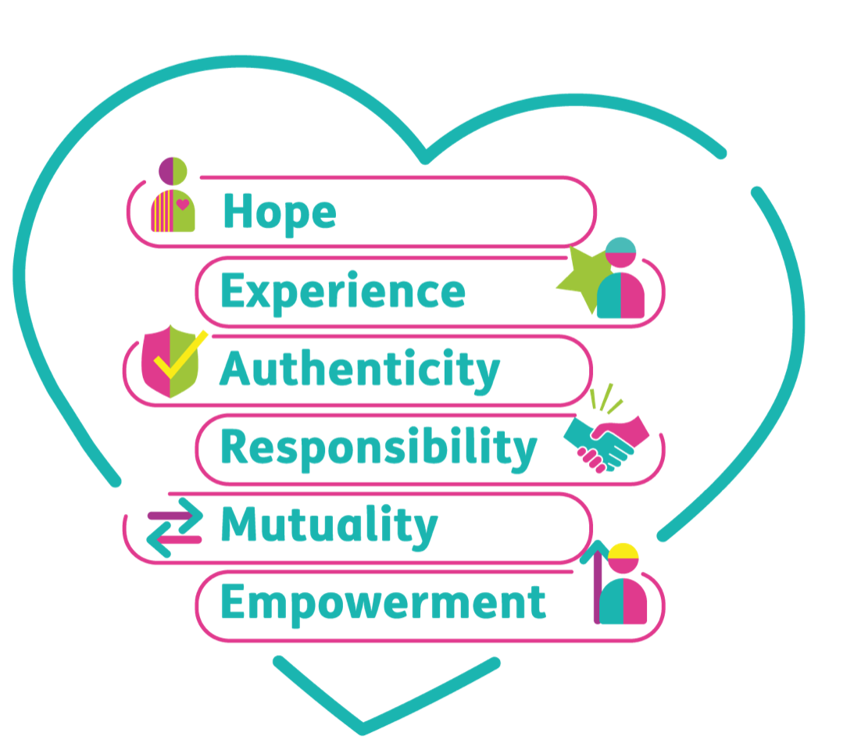
Peer values
Hope: The belief that recovery is possible for everyone.
Experience: We are all experts of our own experience.
Authenticity: Being true to yourself and having relationships that are open, honest and mutual.
Responsibility: Taking ownership of your own wellness and recovery journey.
Mutuality: The peer relationship is two-way,
both people learn, grow, and benefit.
Empowerment: Power is shared and people
are supported to make decisions that feel
right for them.
Peer2Peer: Module two – The peer support relationship

Slide 6
Activity one: HEAR ME
Individual reflection
Read the information in the workbook around HEAR ME values. Highlight or circle points you relate to or can see in your own practice.
Group discussion
Why are peer values important for the peer relationship?
Looking at the HEAR ME values, which ones feel most familiar or intuitive to you and why?
Peer2Peer: Module two – The peer support relationship

Slide 7

Break
Peer2Peer: Module two - The peer support relationship

Slide 8
Peer values into practice
Peer values guide peer support at every level.
Peer values guide the development of peer support
Peer values define what the role is, what makes it distinct from other forms of support, and how peer services are designed.
Peer values guide the delivery of peer support
Peer values influence how we show up in peer relationships. They guide how we listen, share experiences, build trust, set boundaries, and balance power.
Peer2Peer: Module two – The peer support relationship

Slide 9
Peer values into practice
Peer value | Development of peer support | Delivery of peer support
Hope | Be strengths based and use language that focuses on possibility and future | Model recovery in your practice by sharing experiences intentionally
More examples can be found in the participant workbook.
Peer2Peer: Module two – The peer support relationship

Slide 10
Activity two: Peer values into practice
In pairs, review the HEAR ME values and explore ways you may show this value in your peer practice. There is a table in the workbook that shows examples for how each value may look in the development and delivery of peer support to help guide your thinking and capture your ideas.
Peer2Peer: Module two – The peer support relationship

Slide 11
Values-led reflective practice
Reflective practice is a core part of peer support.
It is the ongoing process of pausing to notice how our values, behaviour, and experiences shape the peer relationship. It can be done individually or with others.
Reflective practice helps us stay connected to our own personal recovery and the purpose of the role, and ensures our practice is intentional and relational.
HEAR ME provides a framework for us to do values-led reflective practice.
Peer2Peer: Module two – The peer support relationship

Slide 12
Activity three: Reflective practice
Case study: Luca and Michael
Group discussion
Use the HEAR ME reflective practice tool in the workbook to guide discussions as you role play a
co-reflection session.
Pretend Luca is a member of your group and think about how his practice reflected the peer values, and where he needs to develop practice further.
Alternatively, a member of the group may wish to use an interaction from their own peer support experiences as the case study for this activity.
Peer2Peer: Module two – The peer support relationship

Slide 13
Learning intentions
Understand the core values of peer support and their purpose
Explore how peer values shape the development and delivery of peer support
Explore how reflecting through the peer values framework can strengthen peer practice
Peer2Peer: Module two – The peer support relationship

Slide 14

Checking out question
What’s one thing you are taking away from today’s session?
Peer2Peer: Module two – The peer support relationship

