Slide 1



Connecting through communication
Peer2Peer slides: module two,
session two
Module 2: The peer support relationship

Slide 2

Learning intentions
Explore connection, disconnection and reconnection in the peer relationship
Understand key communication skills and recovery language
Practice active listening skills
Peer2Peer: Module two - The peer support relationship

Slide 3





Group learning agreement
Connections
Device free environment, maintaining confidentiality
Hope
Focusing on the possible
Identity
Respect everyone's individuality
Meaning
Value different perspectives, even if we don’t all agree
Empowerment
Give everyone a chance to speak
Peer2Peer: Module two - The peer support relationship

Slide 4

Checking in question
Think of a time when you felt genuinely listened to. What was it about the interaction that helped you feel understood and connected?
Peer2Peer: Module two - The peer support relationship

Slide 5
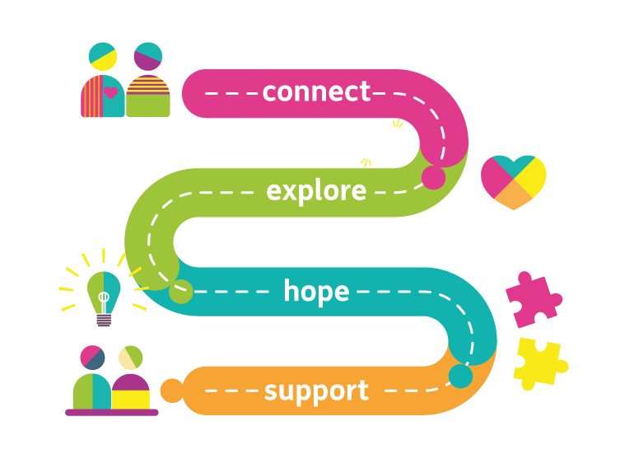
Connecting in the peer relationship
Connection sits at the heart of peer support because it’s the foundation for trust and mutuality. We build that connection through the way we communicate; our words, our presence, curiosity, and willingness to really listen.
Peer2Peer: Module two - The peer support relationship

Slide 6
Connection, disconnection and reconnection
Being able to notice when connection slips, even in small ways, is part of what makes peer support intentional and mutual.
This is a natural part of peer support, the skill is in noticing when disconnection happens and making a reconnection.
Moments of disconnection are invitations to pause, get curious, and check in with each other about what’s happening in the peer relationship.
Peer2Peer: Module two - The peer support relationship

Slide 7
Activity one: Connection, disconnection and reconnection
Role play
Three volunteers will take part in role play scenarios which show connection, disconnection and reconnection.
Share your observations on each scenario
Peer2Peer: Module two - The peer support relationship

Slide 8

Break
Break
Peer2Peer: Module two - The peer support relationship

Slide 9
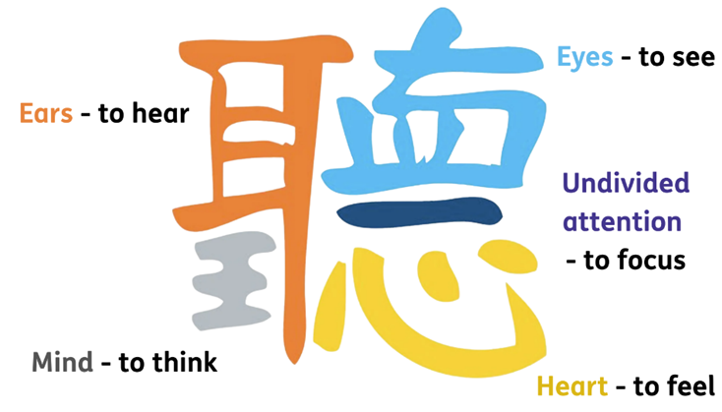
Active listening: TING
The Chinese character 聽 (Ting) helps to describe active listening through the following components:
Peer2Peer: Module two - The peer support relationship

Slide 10
Activity two: Active listening
In pairs you will complete the following active listening activity using Ting.
Round one: Everyday listening
The speaker will talk for 1-2 minutes about a neutral topic (e.g. highlights from the last week)
The listener will listen as normal, using no techniques. You will feedback for around 1 minute what you heard
Round one debrief (take notes in workbook)
Speaker: What did it feel like to be listened to in that way?
Listener: What did you notice about your attention?
Peer2Peer: Module two - The peer support relationship

Slide 11
Activity two: Active listening
Round two: Listening with Ting
The speaker will now talk for 1-2 minutes about a topic they feel a little more passionate about (e.g. something they are looking forward to or a hobby)
The listener will intentionally listen using the elements of Ting. You will feedback for around 1 minute the following:
  What you heard
  What you sensed
  What you felt moved by
Round two debrief (take notes in workbook)
Speaker: What felt different this time?
Listener: Which parts of Ting were easiest or hardest to do?
Peer2Peer: Module two - The peer support relationship

Slide 12
Communication skills
Communication in peer support is a powerful way of building trust, mutuality, and connection. Below are ten key skills and techniques of effective and intentional communication:
Active listening
Listening from a position of not knowing
Listening for the untold story
Providing validation
Reflecting on feelings and emotions
Asking clarifying questions
Asking powerful questions
Using recovery language
Direct, honest and respectful communication
Sitting comfortably with silence
Peer2Peer: Module two - The peer support relationship

Slide 13
Recovery language
Language is one of the ways to foster and enhance recovery-supporting environments. Recovery language is closely associated with our ability to share hope and identify strengths.
When we use recovery language it:
• Promotes hope
• Treats people as individuals
• Treats people as equals/addresses power imbalance
• Provides a positive sense of self/identity
• Promotes positive feelings about oneself and future
• Reduces labelling and stigma and categorising
• Allows individuals to use their own words to share their own experiences
• Promotes choice and self-advocacy
• Promotes a person’s strengths and skill
Peer2Peer: Module two - The peer support relationship

Slide 14
Activity three: Empowering interactions
In groups of three, practice communication skills through role playing peer support scenarios. Each person will take on one of the following roles:
Person being supported should think of a scenario they wish to discuss with the peer supporter or use one of the examples in the workbook
The peer worker takes the discussion from there and they should have a conversation for 5 minutes back and forth
The observer should use the table of the 10 key communication skills in the workbook to record what they see – either tick or make notes. After the role play, the observer should aim to use these same skills to describe the positives and areas for improvement
Peer2Peer: Module two - The peer support relationship

Slide 15
Learning intentions
Explore connection, disconnection and reconnection in the peer relationship
Understand key communication skills and recovery language
Practice active listening skills
Peer2Peer: Module two - The peer support relationship

Slide 16

Checking out question
What’s one thing you are taking away from today’s session?
Peer2Peer: Module two - The peer support relationship

