Slide 1



Intentionally sharing lived experience
Peer2Peer slides: module two,
session one
Module 2: The peer support relationship

Slide 2
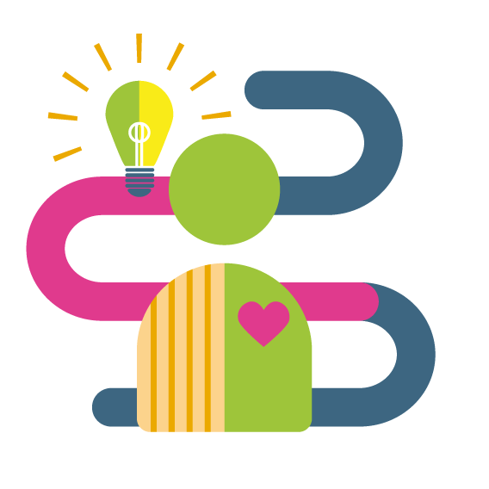
Learning intentions
Understand the purpose of sharing lived experience
Explore how connecting through lived experience can create hope in the peer relationship
Develop skills and experience in sharing lived experiences in ways that are helpful
Peer2Peer: Module two - The peer support relationship

Slide 3





Group learning agreement
Connections
Device free environment, maintaining confidentiality
Hope
Focusing on the possible
Identity
Respect everyone's individuality
Meaning
Value different perspectives, even if we don’t all agree
Empowerment
Give everyone a chance to speak
Peer2Peer: Module two - The peer support relationship

Slide 4

Checking in question
One word to describe how it feels when you hear someone else share an experience that you relate to?
Peer2Peer: Module two - The peer support relationship

Slide 5
Sharing lived experience
Lived experience refers to the personal knowledge someone gains from directly going through a particular situation, challenge or life context
In the peer support relationship, using and drawing on lived experiences is a powerful tool in communicating hope and creating connections with others
The sharing of experiences should be in keeping with key aspects of the peer support relationship;
  Mutual
  Authentic
  Intentional
Peer2Peer: Module two - The peer support relationship

Slide 6
Sharing to create hope
The key thing about sharing lived experience is to maintain hope within the peer support relationship. To do this we need to:
  Seek to discover common ground
  Recognise that each person is unique
  Understand that each person’s experience reflects what they have come to know because of where they have been.
There’s a big difference between sharing a story that centres illness and one that centres recovery:
Illness‑focused stories: pull people toward sympathy or overwhelm
Recovery‑focused: creates space for learning, offers honesty and hope without needing to tell everything at once
Peer2Peer: Module two - The peer support relationship

Slide 7

“I am not what happened to me, I am what I choose to become.”
― Carl Gustav Jung
Peer2Peer: Module two - The peer support relationship

Slide 8
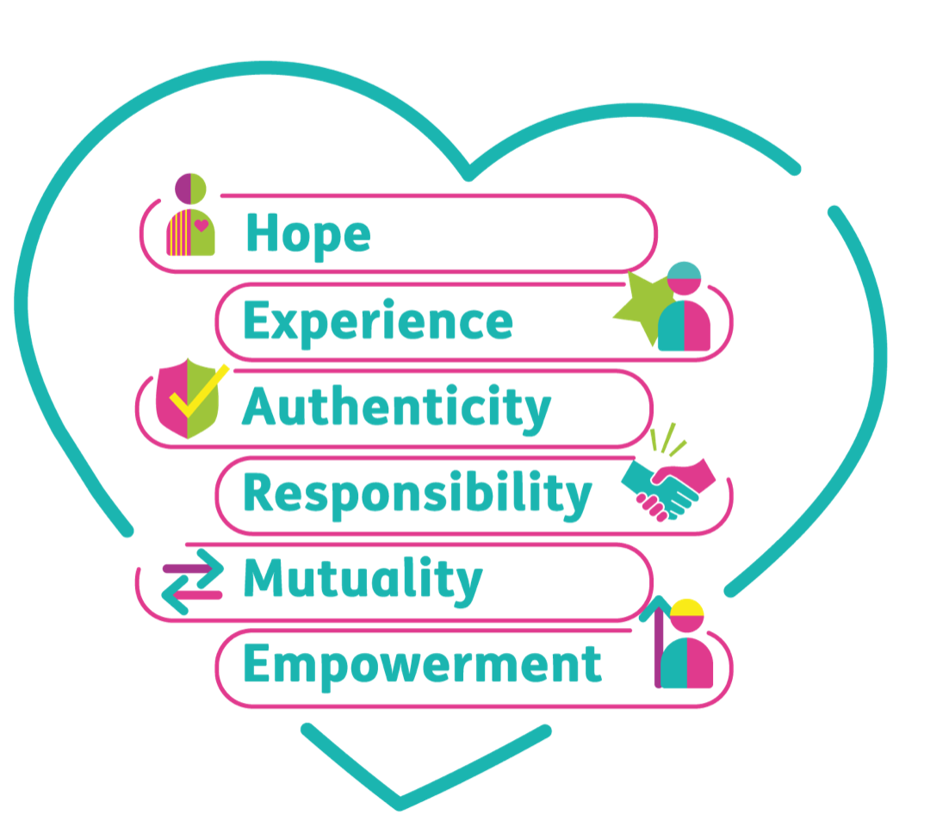
Activity one: Sharing lived experiences
through a peer lens
Individual reflection
Think of a conversation with a peer that you have found helpful
How did the person share their experience?
Why did you find it helpful?
What could have got in the way?
Group discussion
Pick two values from HEAR ME
What does this value look like in
practice when sharing lived experience?
For example, Authenticity is naming my
experience in my own words rather than
using clinical language
Peer2Peer: Module two - The peer support relationship

Slide 9

Break
Break
Peer2Peer: Module two - The peer support relationship

Slide 10
Activity two: Role play practice
In groups of 3, practice how you would share your lived experience through the following roles (more information on each role in your workbook):
Individual
Peer worker
Observer
Discuss where the interactions were mutual, authentic and intentional. The observer should share what they saw that worked well and potential to develop.
Repeat the activity so that each person has the opportunity to play each role.
Peer2Peer: Module two - The peer support relationship

Slide 11
Self-care
We need to mindful of some of the personal impacts of sharing our experiences
Some people have expressed feeling a ‘vulnerability hangover’
There are things we can do to look after ourself during this process such as building in time for self-care following a session
There are also things our peers and organisation can do to promote self-care, such as co-reflection time and supervision
“You can’t pour from an empty cup” – let’s think about what we need to fill our cup.
Peer2Peer: Module two - The peer support relationship

Slide 12

Activity three: Self-care discussion
In small groups, reflect on the following question:
How do you take care of yourself before, during, and after sharing lived experience?
Peer2Peer: Module two - The peer support relationship

Slide 13
Learning intentions
Understand the purpose of sharing lived experience
Explore how connecting through lived experience can create hope in the peer relationship
Develop skills and experience in sharing lived experiences in ways that are helpful
Peer2Peer: Module two - The peer support relationship

Slide 14

Checking out question
What’s one thing you are taking away from today’s session?
Peer2Peer: Module two - The peer support relationship

