Slide 1


Peer values
Peer2Peer slides: module one,
session four
Module 1: Introducing Peer Support

Slide 2

Learning intentions
Explore how personal values can guide peer‑to‑peer interactions
Understand the core values of peer support, including their roots in lived experience movements
Reflect on how peer values influence peer practice
Peer2Peer: Module one - Introducing peer support

Slide 3





Group learning agreement
Connections
Device free environment, maintaining confidentiality
Hope
Focusing on the possible
Identity
Respect everyone's individuality
Meaning
Value different perspectives, even if we don’t all agree
Empowerment
Give everyone a chance to speak
Peer2Peer: Module one - Introducing Peer Support

Slide 4

Checking in question
What’s something you think makes support feel ‘human’ rather than ‘formal’?
Peer2Peer: Module one - Introducing peer support

Slide 5
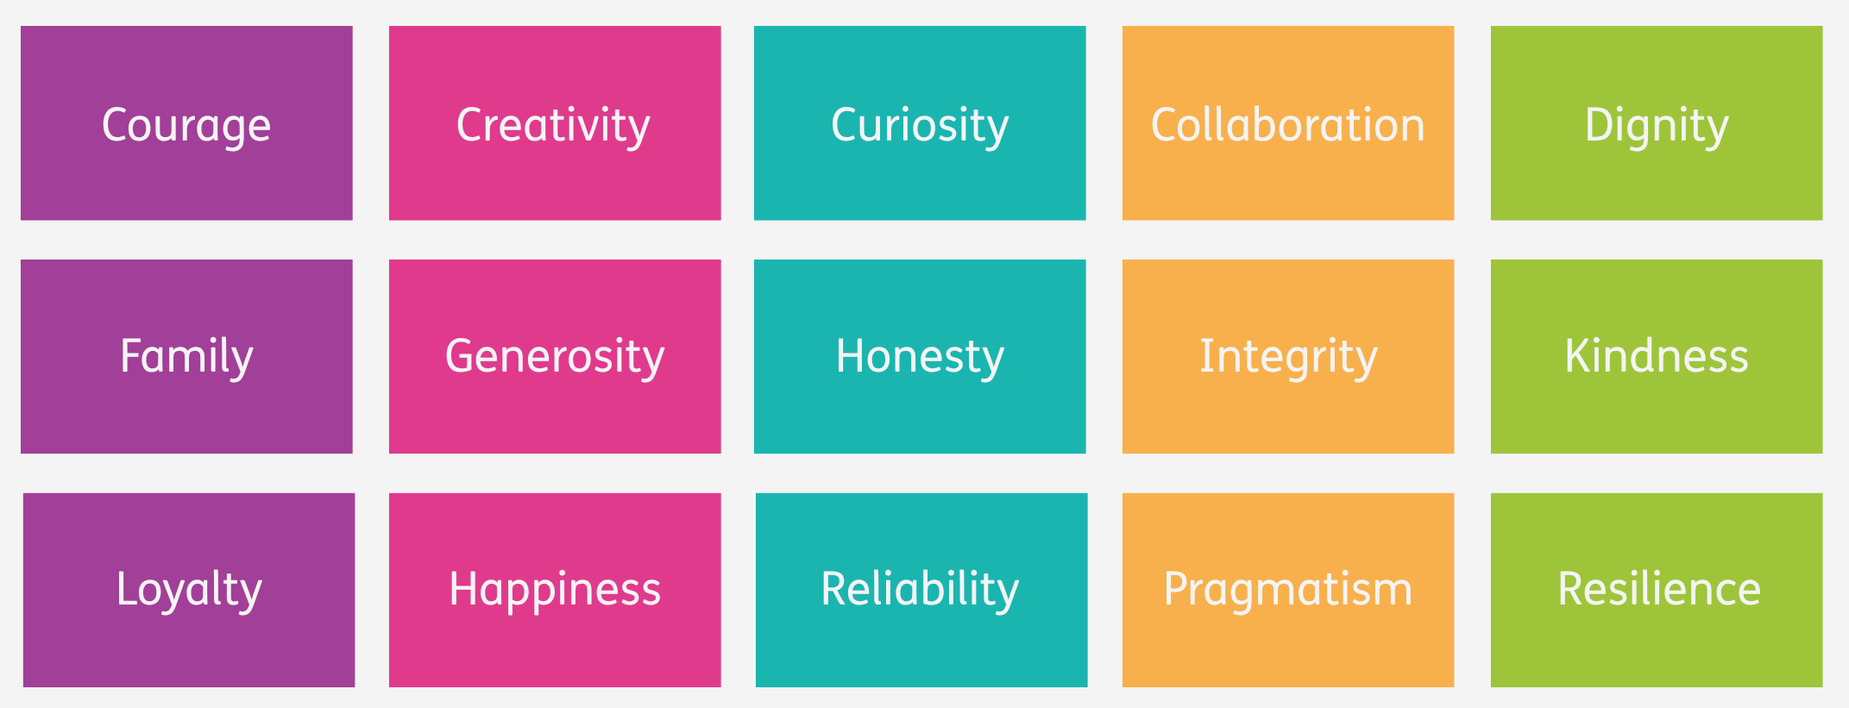
Personal values
Values are the guiding principles or beliefs that shape what a person, group, or community sees as important, meaningful, or “the right thing to do.” They influence how we make decisions, how we behave, and what we prioritise in everyday life.
Examples of personal values
Peer2Peer: Module one - Introducing peer support

Slide 6


Activity one: Reflecting on values
Reflection
Reflect on your own personal values
using the prompts in the workbook
Group discussion
Think of a time someone supported you in a way that really helped. What did they do, and how might that shape the way you support others?
When you’re with someone who’s struggling, what values might you draw on to support them?
Peer2Peer: Module one - Introducing peer support

Slide 7

Break
Peer2Peer: Module one - Introducing peer support

Slide 8
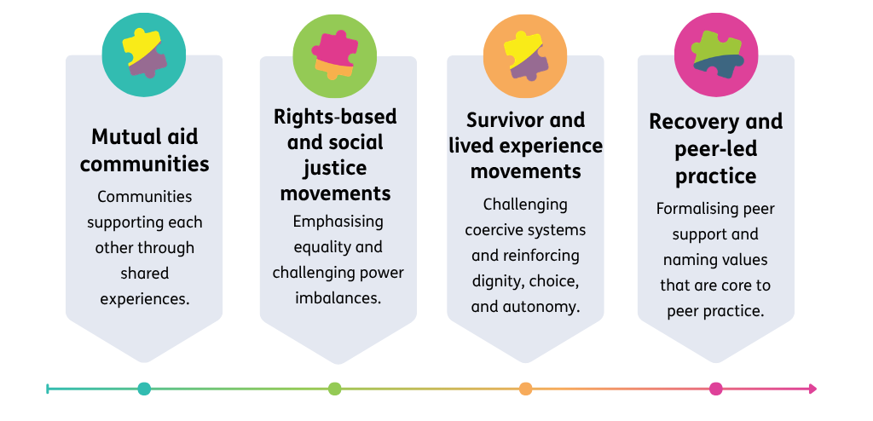

History of peer values
Peer values grew from people supporting each other as equals, honouring lived experience, and creating spaces of connection, respect, and choice.
Peer2Peer: Module one - Introducing peer support

Slide 9
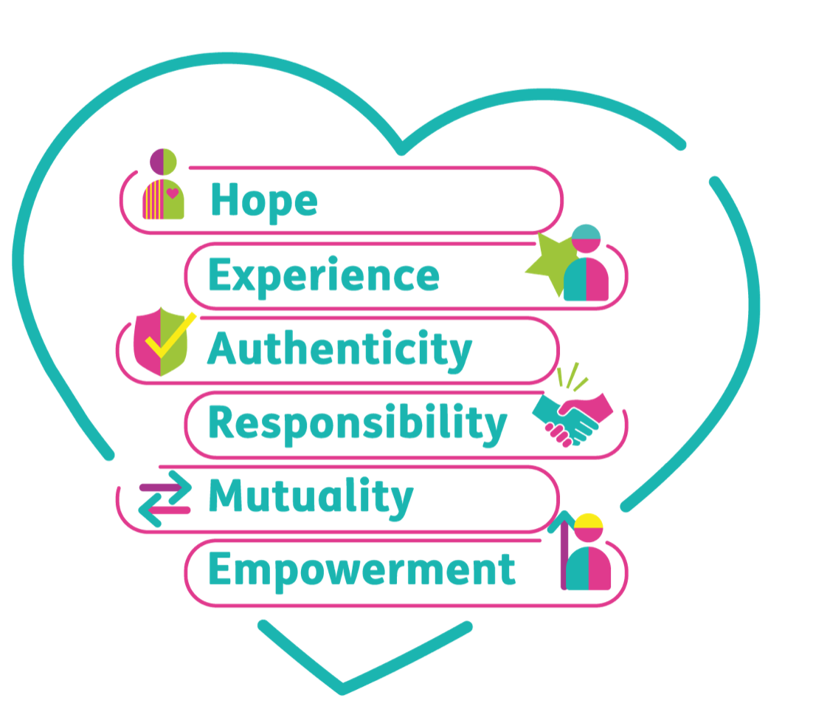
HEAR ME
The peer values framework was developed with peer workers to improve understanding of peer support and ensure that the role of peer workers is clear and remains true to the peer support ethos.
Peer2Peer: Module one - Introducing peer support

Slide 10

Activity two: Values in practice
In small groups, read the example scenarios in the participant workbook
For each scenario
Which HEAR ME values do you see here?
How might this value influence peer practice?
Peer2Peer: Module one - Introducing peer support

Slide 11
Learning intentions
Explore how personal values can guide peer‑to‑peer interactions
Understand the core values of peer support, including their roots in lived experience movements
Reflect on how peer values influence peer practice
Peer2Peer: Module one - Introducing peer support

Slide 12

Checking out question
What’s one thing you are taking away from today’s session?
Peer2Peer: Module one - Introducing peer support

