Slide 1


Peer support and recovery
Peer2Peer slides: module one,
session three

Slide 2
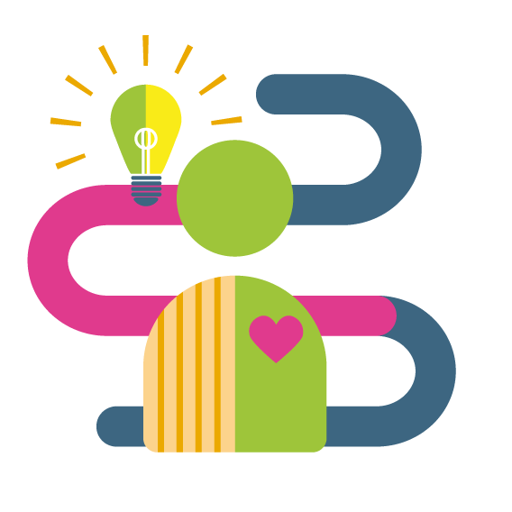
Learning intentions
Co-create an understanding of what a ‘recovery approach’ means and how peer support contributes
Explore the CHIME framework together and share ways to use it in practice
Understand why a strengths-based approach matters in peer support
Peer2Peer: Module one - Introducing peer support

Slide 3





Group learning agreement
Connections
Device free environment, maintaining confidentiality
Hope
Focusing on the possible
Identity
Respect everyone's individuality
Meaning
Value different perspectives, even if we don’t all agree
Empowerment
Give everyone a chance to speak
Peer2Peer: Module one - Introducing peer support

Slide 4

Checking in question
If you had to describe peer support in one word or phrase, what would you choose?
Peer2Peer: Module one - Introducing peer support

Slide 5

What does recovery mean?
“Rather than fight the illness, I felt like I had to accept it.
I’m not fighting you anymore. What I am going to do is I
am going to try and work with you and work round you
and see if I can get some kind of peace.”
“It’s a journey, there’s always room for learning and improvement so I’m always improving.”
“Recovery to me meant that I was spending more positive time with my family and I wasn’t always in the house all the time…I love sharing things with other people.”
“At first it was like having a jigsaw without the picture, then finding the pieces as I went along until finally I got it. I got the whole picture.”
Excerpts from the Making Recovery Real in Dundee films
Peer2Peer: Module one - Introducing peer support

Slide 6
Activity one: Defining recovery
Individual reflection
Reflect on the quotes in the workbook, highlight or circle words you are drawn to and begin to create your own definition of recovery
Group discussion
Discuss your reflections on the quotes and if comfortable, share your definitions of recovery as a group
Peer2Peer: Module one - Introducing peer support

Slide 7
CHIME framework
C | Connections | Having relationships and being connected with other people in a positive way.
H | Hope | Having hope that recovery is possible and the motivation to change.
I | Identity | Regaining a positive sense of self and identity.
M | Meaning | Finding one’s own meaning and purpose in life.
E | Empowerment | Focussing on strengths and having control over life.
Peer2Peer: Module one - Introducing peer support

Slide 8

Break
Peer2Peer: Module one - Introducing peer support

Slide 9
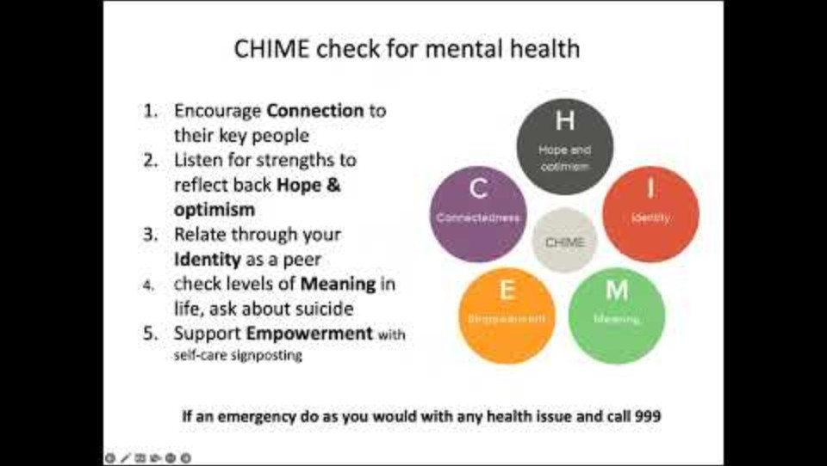
Moray Wellbeing Hub and CHIME
Peer2Peer: Module one - Introducing peer support

Slide 10
Activity two: Using CHIME in practice
How might you use CHIME in your personal life, work life, or in future peer practice?
Share your ideas with the room and together we will create a mind map!
Peer2Peer: Module one - Introducing peer support

Slide 11
Strengths-based approach
Promotes hope, identifying strengths and abilities generates hope, a key ingredient of recovery
Recognises and validates the experience brought by people with experience of mental health problems
Promotes resilience, people who are more aware of their strengths are more able to anticipate and bounce back from challenges
Recognises each person as a unique individual with strengths, goals and dreams rather than as a collection of problems
Encourages empowerment
Focusing on strengths does not mean that people will not experience problems, but it does help to foster environments and learning opportunities that support recovery
Peer2Peer: Module one - Introducing peer support

Slide 12
Learning intentions
Co-create an understanding of what a ‘recovery approach’ means and how peer support contributes
Explore the CHIME framework together and share ways to use it in practice
Understand why a strengths-based approach matters in peer support
Peer2Peer: Module one - Introducing peer support

Slide 13

Checking out question
What’s one thing you are taking away from today’s session?
Peer2Peer: Module one - Introducing peer support

