Slide 1


Peer group facilitation
Peer2Peer slides: module three,
session one
Module 1: Introducing Peer Support

Slide 2

Learning intentions
Explore the role of the peer group facilitator in creating empowering peer spaces
Understand group dynamics and explore the facilitators' role in responding to challenging group dynamics
Explore boundaries in peer group settings
Peer2Peer: Module three – Peer concepts and practice

Slide 3





Group learning agreement
Connections
Device free environment, maintaining confidentiality
Hope
Focusing on the possible
Identity
Respect everyone's individuality
Meaning
Value different perspectives, even if we don’t all agree
Empowerment
Give everyone a chance to speak
Peer2Peer: Module three – Peer concepts and practice

Slide 4

What kind of facilitator do you want to be?
Checking in question
Peer2Peer: Module three – Peer concepts and practice

Slide 5
The role of peer group facilitators
The role of the peer facilitator is to host the group, to hold a safe space for people to contribute, to gently steer the group and to role model engagement and participation.
There’s no ‘one size fits all’ way to facilitate a peer space. The magic comes from people bringing their full selves into the space. Every facilitator is different, and that variety is what makes peer support unique.
Peer2Peer: Module three – Peer concepts and practice

Slide 6
Activity one: Creating empowering spaces
In small groups discuss the following questions:
What does an empowering peer space look and feel like?
What can the peer group facilitator do to create this space?
Peer2Peer: Module three – Peer concepts and practice

Slide 7
Creating empowering spaces
The peer facilitator role is hugely important because it will help guide conversations and create empowering spaces. Facilitators can create these spaces through:
Group agreements
Consistent structure
Having a clear purpose of the group
Peer2Peer: Module three – Peer concepts and practice

Slide 8

Break
Peer2Peer: Module three – Peer concepts and practice

Slide 9
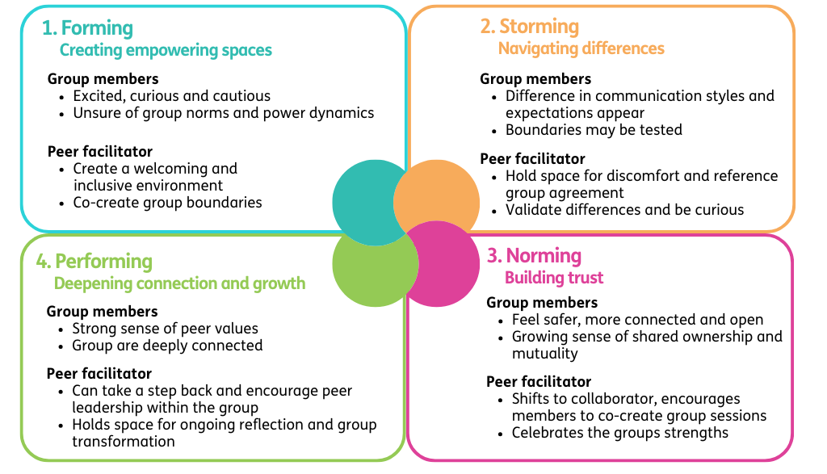
Understanding group dynamics
Peer2Peer: Module three – Peer concepts and practice

Slide 10
Activity two: Understanding group dynamics
In small groups read through your scenario then discuss:
What might be influencing this behaviour?
(Reference the iceberg image in workbook)
What could the facilitator do in the moment?
What could the facilitator do following the session?
Peer2Peer: Module three – Peer concepts and practice

Slide 11
Boundaries in group settings
Peer facilitators must be conscious of maintaining boundaries for themselves and the group. Boundaries exist on several levels:
Personal boundaries – protect our wellbeing
Group boundaries – keep the space safe and empowering
Wider societal boundaries – shape how people understand safety, trust and power
Peer2Peer: Module three – Peer concepts and practice

Slide 12
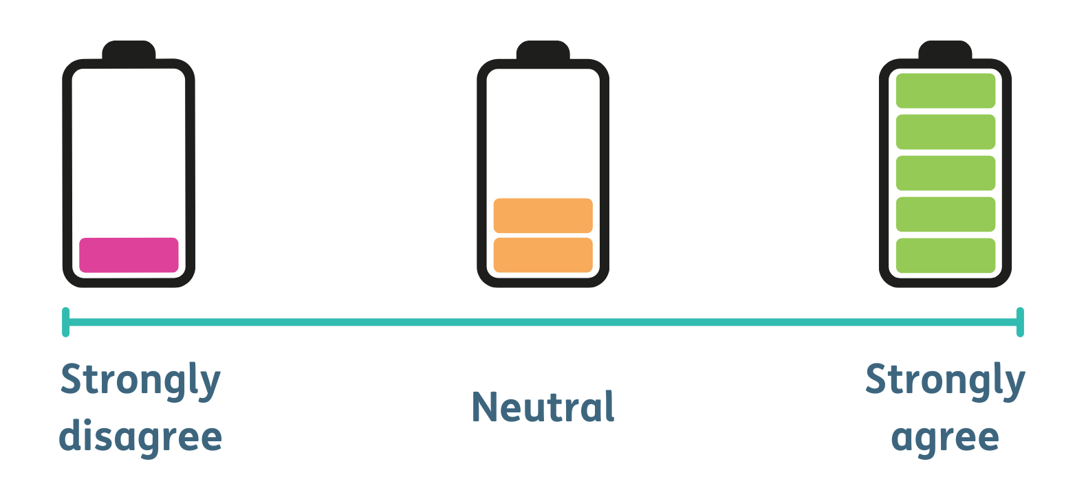
Activity three: Boundary continuum
As a group, decide what statements from the workbook you wish to focus on. Then place yourself on the continuum where you relate to the statement.
Peer2Peer: Module three – Peer concepts and practice

Slide 13
Learning intentions
Explore how the role of the peer group facilitator in creating empowering peer spaces
Understand group dynamics and explore the facilitators' role in responding to challenging group dynamics
Explore boundaries in peer group settings
Peer2Peer: Module three – Peer concepts and practice

Slide 14

Checking out question
What’s one thing you are taking away from today’s session?
Peer2Peer: Module three – Peer concepts and practice

