Slide 1



Boundaries and personal limits
Peer2Peer slides: module two,
session four
Module 2: The peer support relationship

Slide 2

Learning intentions
Explore how we can respectfully negotiate our personal limits and boundaries
Understand that boundaries are an empowering tool for peer practice
Practice setting boundaries and reflect on
different approaches
Peer2Peer: Module two - The peer support relationship

Slide 3

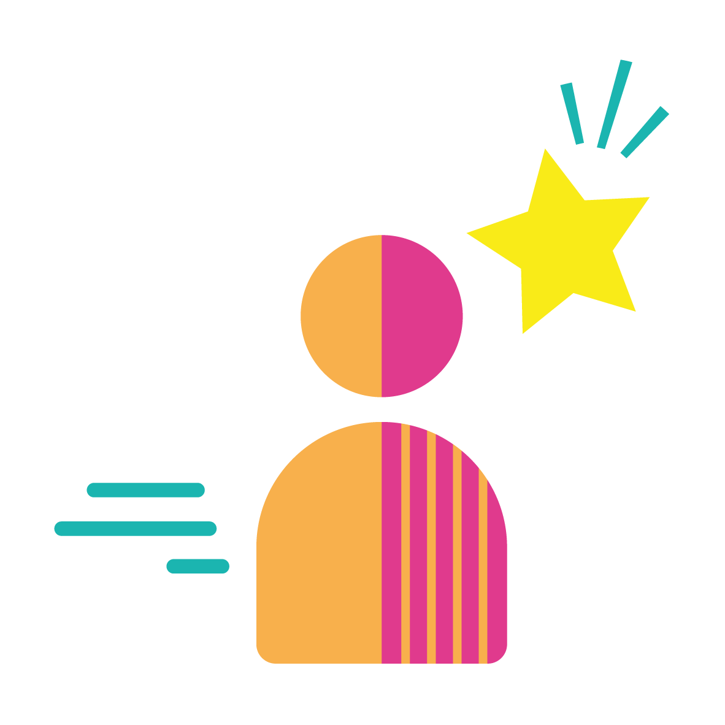



Group learning agreement
Connection
Device free environment, maintaining confidentiality
Hope
Focusing on the possible
Identity
Respect everyone's individuality
Meaning
Value different perspectives, even if we don’t all agree
Empowerment
Give everyone a chance to speak
Peer2Peer: Module two - The peer support relationship

Slide 4
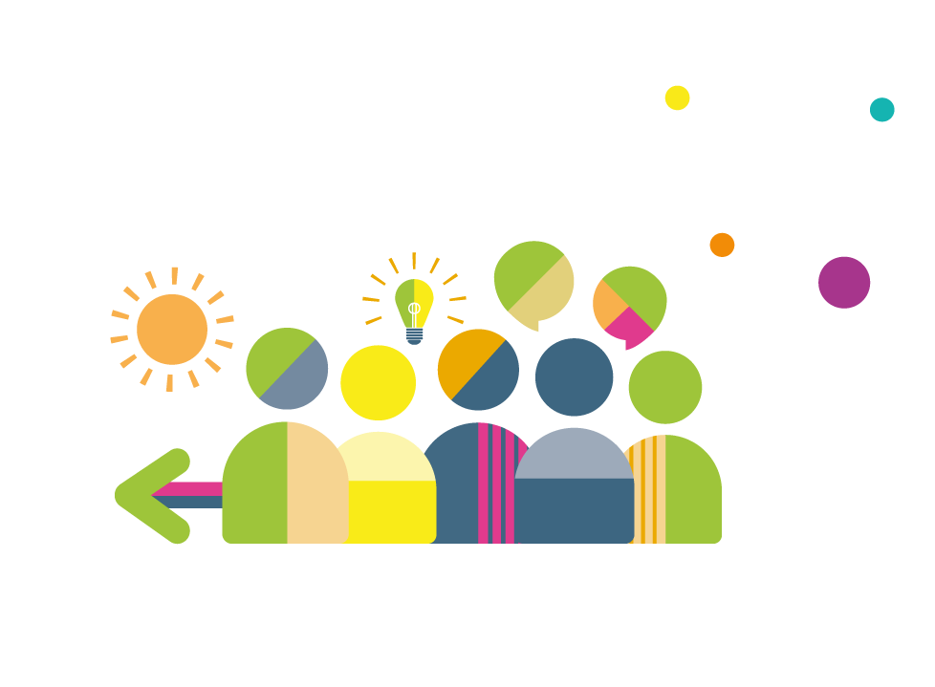
Checking in question
When you hear the word ‘boundaries’, what comes to mind?
Peer2Peer: Module two - The peer support relationship

Slide 5
Personal limits
Personal limits are the guidelines and 'rules' that we set ourselves to ensure that we're prioritising our own values and beliefs.
It is our personal limits that influence the boundaries we may set for ourselves, for example:
Personal limit: I need personal time after work to recharge my batteries
Boundary: I will not answer work emails after 6pm
Negotiating personal limits in a relationship is not about shutting people out, it’s about protecting yourself and your ability to stay connected in the relationship
Peer2Peer: Module two - The peer support relationship

Slide 6
Activity one: Reflecting on personal limits
Individual reflection
What are your personal limits that help you stay connected in the peer relationship?
What helps you feel confident expressing your personal limits?
What makes it harder for you to say “I can’t do that”?
Group discussion
What does respectful negotiation look like when someone’s needs or request is at odds with your personal limits?
Peer2Peer: Module two - The peer support relationship

Slide 7
Boundaries
Boundaries refer to the borders or limits of a relationship. They relate to what is and what is not acceptable, and the types of boundaries that exist vary depending on the type of relationship
In peer support, the negotiation of boundaries should be mutual – it is not about one person imposing on the other, both people’s personal limits are important
Boundaries are an empowering tool in peer support when they are communicated openly, and the negotiation is mutual and respectful
Boundaries are less about saying “no” and more about saying “this is how we can be in this together in a way that works for both of us”
Peer2Peer: Module two - The peer support relationship

Slide 8
Negotiating boundaries
There can be an added element of organisational boundaries and group boundaries depending on the setting
Organisational boundaries
In formal peer roles, there may be an expectation to share updates with a team. This can be negotiated in the peer relationship by deciding together what information is shared
Group boundaries
In peer groups, a group agreement (similar to the learning agreement) is a way to mutually agree the boundaries for the group space, and this can evolve as relationships deepen
Peer2Peer: Module two - The peer support relationship

Slide 9

“Boundaries are what help me love you and love me at the same time”
― Prentis Hemphill
Peer2Peer: Module two - The peer support relationship

Slide 10

Break
Break
Peer2Peer: Module two - The peer support relationship

Slide 11
Activity two: Negotiating boundaries
In small groups, reflect on the scenario you have been provided with then discuss the following questions:
What boundaries issues does this raise?
What does the peer supporter need to consider?
What approaches could be taken and what would the implications be of each?
Peer2Peer: Module two - The peer support relationship

Slide 12
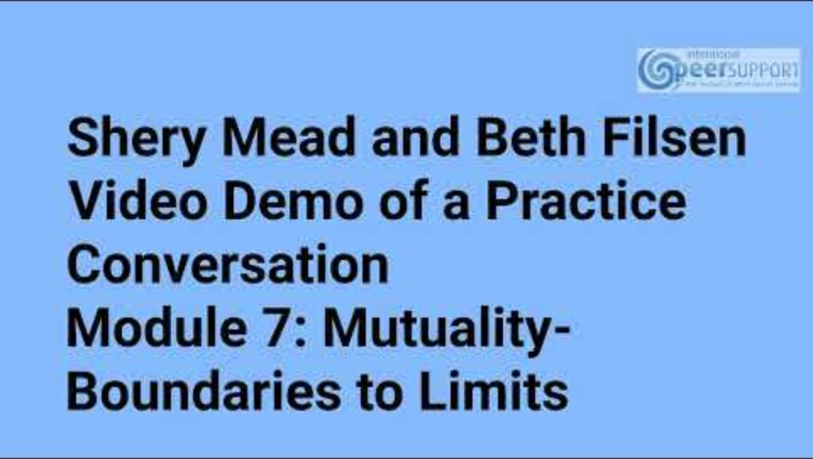
Film: Intentional peer support
Peer2Peer: Module two - The peer support relationship

Slide 13
Activity three: Role play practice
In pairs, practice responding to a boundary pushing scenario through role play. You may wish to use one of the examples, or create your own. Continue the role play conversation back and forth until there is a resolution. After the role play, reflect on the following questions:
What went well in the role play?
What could have been better?
Swap over and choose a different example so both people get a turn responding
Peer2Peer: Module two - The peer support relationship

Slide 14
Role play starter examples
My benefits haven’t come through, could I borrow some money from you?
Could we meet for a coffee outside of the usual sessions?
I tried calling you last night, why didn’t you answer?
Can you keep what I told you today completely secret, even from your team?
I’m struggling to make friends, would you say we are friends?
I saw you in town yesterday, why didn’t you say hi?
Could you give me a lift home after our session?
Can I follow you on Instagram so we can stay in touch?
Peer2Peer: Module two - The peer support relationship

Slide 15
Learning intentions
Explore how we can respectfully negotiate our personal limits and boundaries
Understand that boundaries are an empowering tool for peer practice
Practice setting boundaries and reflect on
different approaches
Peer2Peer: Module two - The peer support relationship

Slide 16

Checking out question
What’s one thing you are taking away from today’s session?
Peer2Peer: Module two - The peer support relationship

